Slide 1
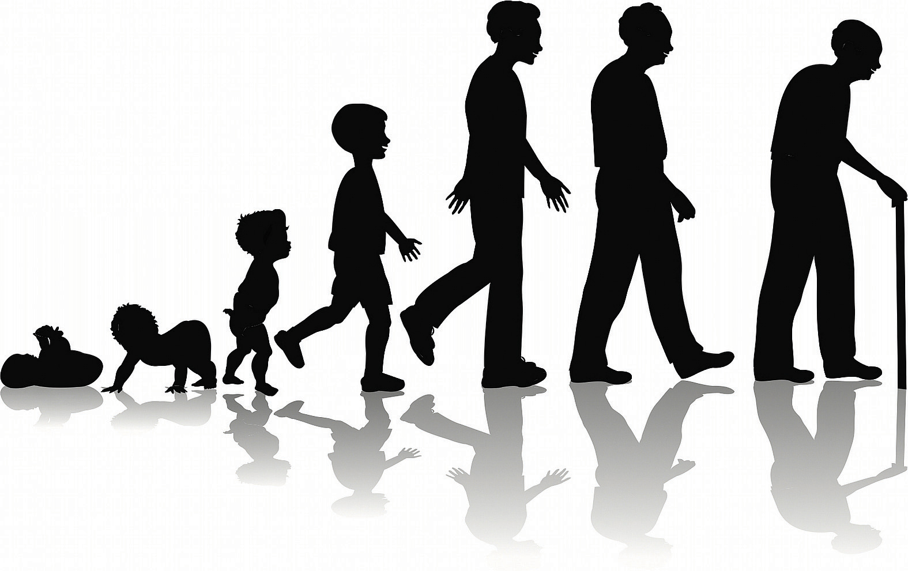
Pandemic
“Adjustment”

Slide 2
Mental Health
“Signs
&
Symptoms”
Increased Irritability Increased Worry thoughts
Binge Watching, surfing, etc Increased isolation
Feeling Nervous, Anxious Poor appetite or Overeating
Increased Fatigue Trouble Concentrating
Increased Sadness Decreased Productivity
Increased Energy Hypersomnia or Insomnia

Slide 3
Pandemic hacks

Slide 4

Creating A Routine
“Structure, Reliability, & Predictability”

Slide 5

Building Daily Positive Experiences

Slide 6
Daily Mindful Engagement
“Present Moment”
“What!”
“How!”
Observe
Describe
Participate
One Mindfully
Non-Judgmentally
Effectively

Slide 7
Check & Connect
“Communicate: Emotions, Capacity, Needs”
Self
In this moment
Partner/others
In this moment
Where am I emotionally?
How much Capacity do I have?
What are my needs?
What can I do about my needs?
What do I need from my partner/others
Actively Listen/ Validate
Actively Listen/ Validate
Actively Listen/ Validate
Listen/ Appreciate
Listen, Offer according to CAPACITY, Empathize with compassion

